Slide 1
US Genetic Evaluation for New Calf Health Traits: Diarrhea and Respiratory Illnesses
Mahesh Neupane, Kristen L. Parker Gaddis, Sajjad Toghiani, Asha M. Miles, Jason R. Graham, Javier F. Burchard, João W. Dürr, John B. Cole*, Jeffrey R. O'Connell, Curtis P. Van Tassell, and Paul M. VanRaden

Slide 2
Background
Calf health is a critical factor in the sustainability and profitability of dairy farming
75% of preweaned calf mortality is due to diarrhea (53-56%) and respiratory disease (21-23%)
In postweaning mortality, respiratory disease accounts for 50% of cases
No US national evaluation of calf health/disease traits, only heifer livability
Low heritability (0.02 – 0.21) and lack of centralized records/reporting
Is there enough good quality data leading to national evaluation?
Lynch et al., 2024; Gaddis et al., 2020; Cole et al., 2008
Notes:
Calf health is a critical factor in the sustainability and profitability of dairy farming
Progress has been made in selection of healthy calf based on other traits such as productive life. Although indirect selection has helped to identify healthy calves, direct selection could improve future outcomes of both young stock and lactating dairy cows.
Commercially calf wellness trait index (scours, respiratory disease, and calf livability) is available from Zoetis®
Heritability depends upon incidence rate of disease, methods used (linear vs threshold), phenotype classification, study design, data recording, and editing practices
To address the lack of centralized records, format 6 was developed in 2008 to record calf and cow health events

Slide 3
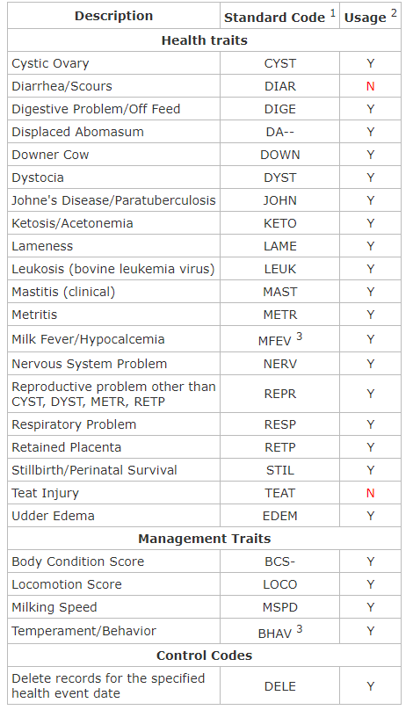
Format 6 (health data)
Developed in 2008, latest revision in 2017
Codes for 20 health traits and 4 management traits
6 cow health traits US national evaluation from 2018
DA, MFEV, KETO, MAST, METR, RETP
https://redmine.uscdcb.com/projects/cdcb-customer-service/wiki/Format_6#
Notes:
A key limitation in developing direct genetic measures for health traits in the U.S. has been the lack of a centralized national health data collection system. In 2008, the Animal Improvement Program Laboratory (now the Animal Genomics and Improvement Laboratory), in collaboration with industry partners and veterinary experts, developed a standardized health record system. This system was designed to track a wide range of conditions, including clinical mastitis, reproductive issues, metabolic disorders, and injuries and also incorporates four management-related codes: body condition score, locomotion score, temperament, and milking speed. It is compatible with existing data formats: lactation record (Format 4) and reproductive record (Format 5).
The first 100 bytes of each health record follow the structure used by other formats with key identification details such as animal ID, sire and dam ID, herd number, and calving date. After this section, each record can include up to 20 individual segments, with each segment representing a reported health event. These segments provide the standardized health code, the date of the event, and specific details relevant to that event.

Slide 4
Objectives
Develop a comprehensive national genetic evaluation system for dairy calf health traits using producer-recorded health event data (Format 6)
Identify genetic markers associated with key health traits in dairy calves and their possible inclusion in genomic marker panel
Notes:
secondary objectives are to identify genetic markers associated with key health traits in dairy calves and their possible inclusion in genomic marker panel,
promote the adoption of genetic evaluation in breeding programs to improve calf health, and continuous improvement of genetic model and phenotypic data collection.

Slide 5
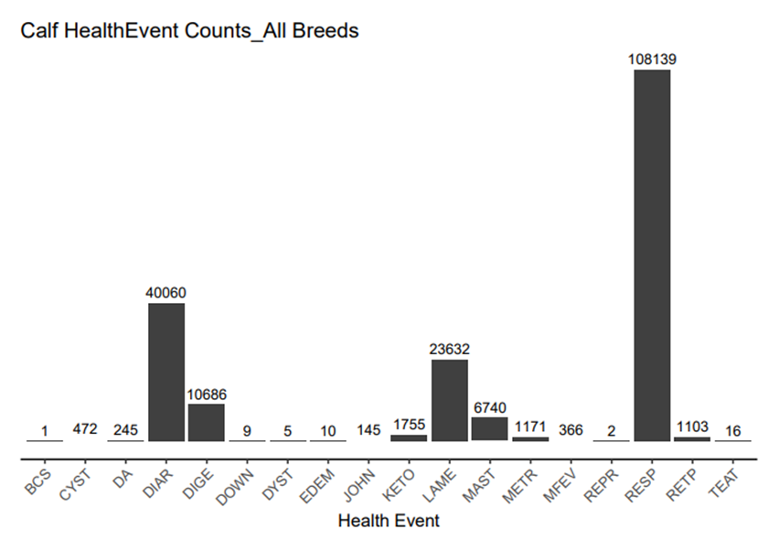
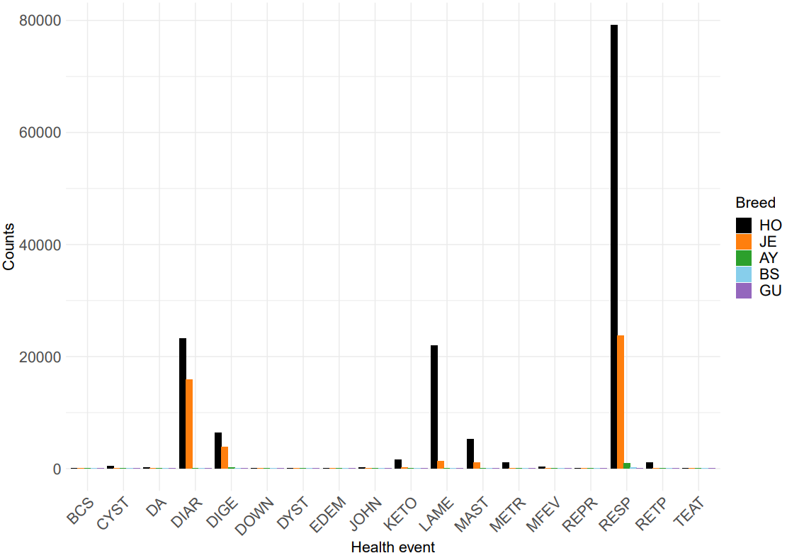
Data extraction: calf health events distribution (2013-2024)
All breeds
Notes:
Out of the many calf health events, only diarrhea (DIAR) and respiratory problems (RESP) have sufficient data. Therefore, our analysis focuses only on these two traits. Additionally, these traits are responsible for the majority of losses, in terms of calf mortality and economic impact.

Slide 6
Data quality control (edits)
Calves in the same herd-year (contemporaries) without the health event of interest were used as healthy animals
For each event, first incidence reported is retained
Herd-year incidence minimum 1% and maximum within 2 SD of mean
Pedigree data: animals with missing sire keys were removed
Notes:
Producer recorded data are noisy, messy, and incomplete
To account for underreporting or data errors, disease incidence in each herd-year was required to exceed a minimum threshold of 1% and a fall below a maximum of 2 standard deviations above the mean disease incidence.

Slide 7
Phenotypes and heritability estimates
Binary trait: 0 (diseased) and 100 (healthy)
DIAR: 207,602 total (14.46% diseased)
RESP: 681,741 total (16.05% diseased)
Majority of data (>97%) from HO (80.3%) and JE (17.2%) breeds
Higher incidence of both diarrhea and respiratory problems in JE as compared to HO
Heritability estimates (blupf90): diar 0.026 and resp 0.022
Mistal et al., 2002

Slide 8
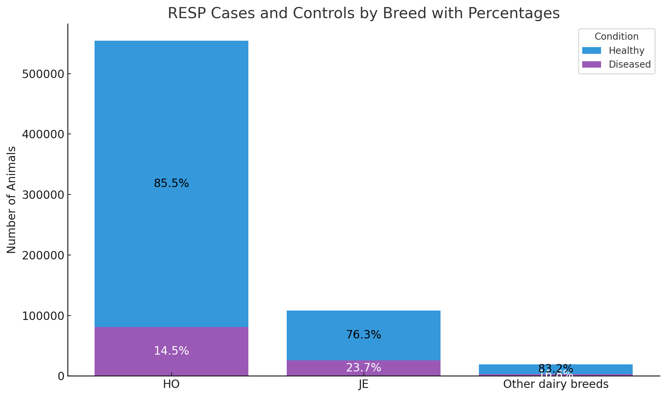
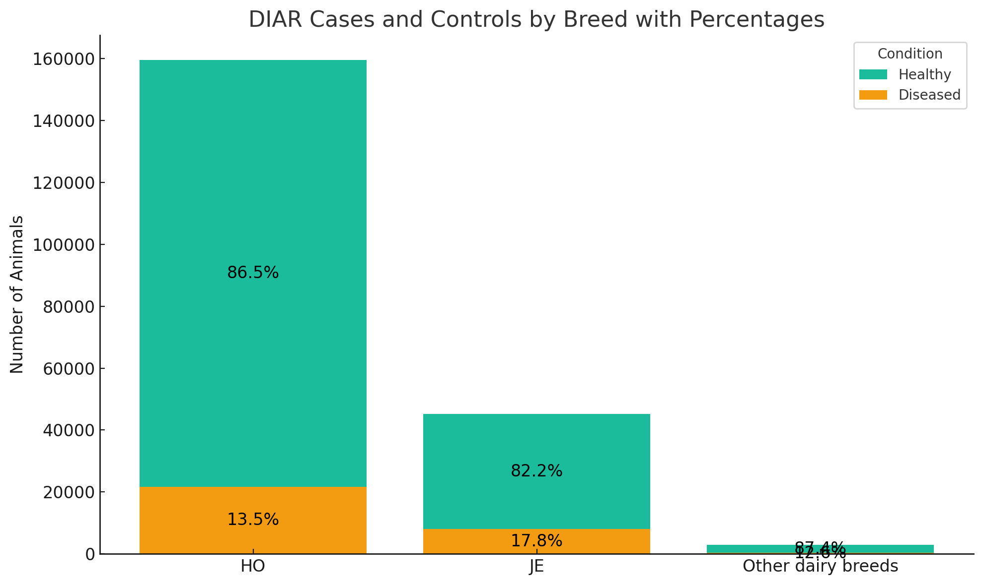
Incidence by breed
DIAR
RESP
Notes:
Higher incidence of both diarrhea and respiratory problems in JE as compared to HO
** JE have smaller body weights but greater surface area, resulting in higher metabolic rate, potentially influencing their resilience (Kleiber, 1932; Quigley, 2012).
** Ballou (2012) reported that peripheral blood mononuclear cells from JE calves produced lower levels of tumor necrosis factor-alpha (TNF-α) when stimulated, compared to HO calves. Suggests breed related differences in immune function…
Higher number calves in respiratory events as event is measured upto 365 days whereas diarrhea event is only measured till 60 days (more on next slide)

Slide 9
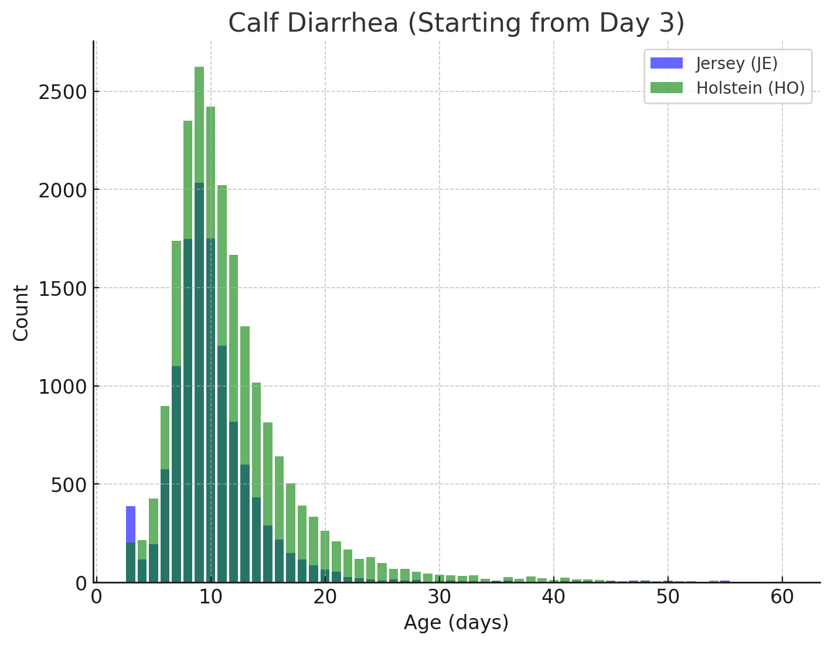
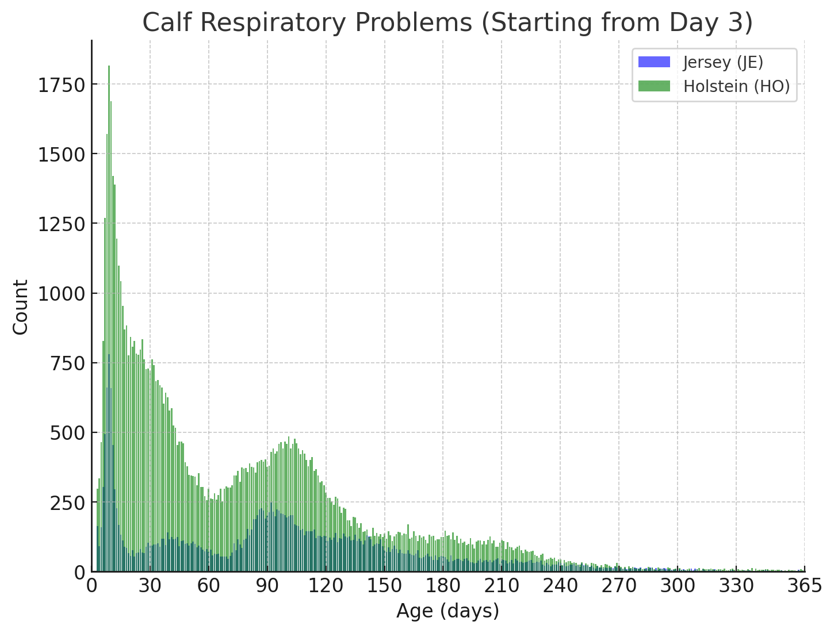
Age distribution of diarrhea and respiratory events in HO and JE calves
Diarrhea
Respiratory problems
Notes:
Diarrhea events upto 60 days and respiratory events up to 365 days were used as phenotypes as it constitutes majority of cases.
Median age for diarrhea 10 days and 68 days for respiratory problems
Second spike in respiratory problem around 100 days (may be due to post-weaning stress)

Slide 10
Predicted transmitting abilities (PTAs)
Predicted Transmitting Abilities (PTAs) were calculated using the animal model: DIAR/RESP = HYS + PG + a + e
covariates: parity of dam and herd-year-season of birth(hys)
All breed model for traditional pedigree-based evaluation and breed specific (JE and HO) for genomic evaluation
All animals genotyped on various platforms were imputed to 69,200 markers using Findhap version 3
Wiggans et al., 2019; VanRaden et al., 2011
Notes:
Parity of dam: First parity dam was further divided into three groups (< 22 mo, between 22-25 mo, and > 25 mo) and embryo transferred heifers were recorded as separate group
Only HO and JE have enough genotypic data for genomic evaluations

Slide 11
Predicted Transmitting Ability (PTA): genomic and pedigree
Trait | Genomic PTA mean ± SD (reliability) |  | Traditional PTA mean ± SD (reliability)
 | Old | Young | Old | Young
DIAR-JE | 0.07 ± 0.36 (34) | 0.08 ± 0.47 (33) | -0.01 ± 0.36 (15) | 0.06 ± 0.52 (15)
RESP-JE | 0.04 ± 0.41 (42) | -0.01 ± 0.48 (39) | 0.03 ± 0.42 (21) | -0.04 ± 0.51 (18)
DIAR-HO | -0.01 ± 0.25 (47) | -0.03 ± 0.34 (45) | -0.00 ± 0.25 (19) | -0.04 ± 0.26 (12)
RESP-HO | -0.04 ± 0.36 (60) | -0.11 ± 0.51 (59) | -0.02 ± 0.35 (26) | -0.08 ± 0.36 (17)
Notes:
PTA and reliability %
Yng: birth >= 2020 (born on or after 2020)
Old: born before 2020
Genomic PTAs have higher reliabilities than traditional ones
With more data and accurate recordings, reliabilities will improve
Holsteins exhibited higher genomic reliabilities for both diarrhea and respiratory traits compared to JE, possibly due to the greater number of genotyped and phenotyped animals included in the study

Slide 12
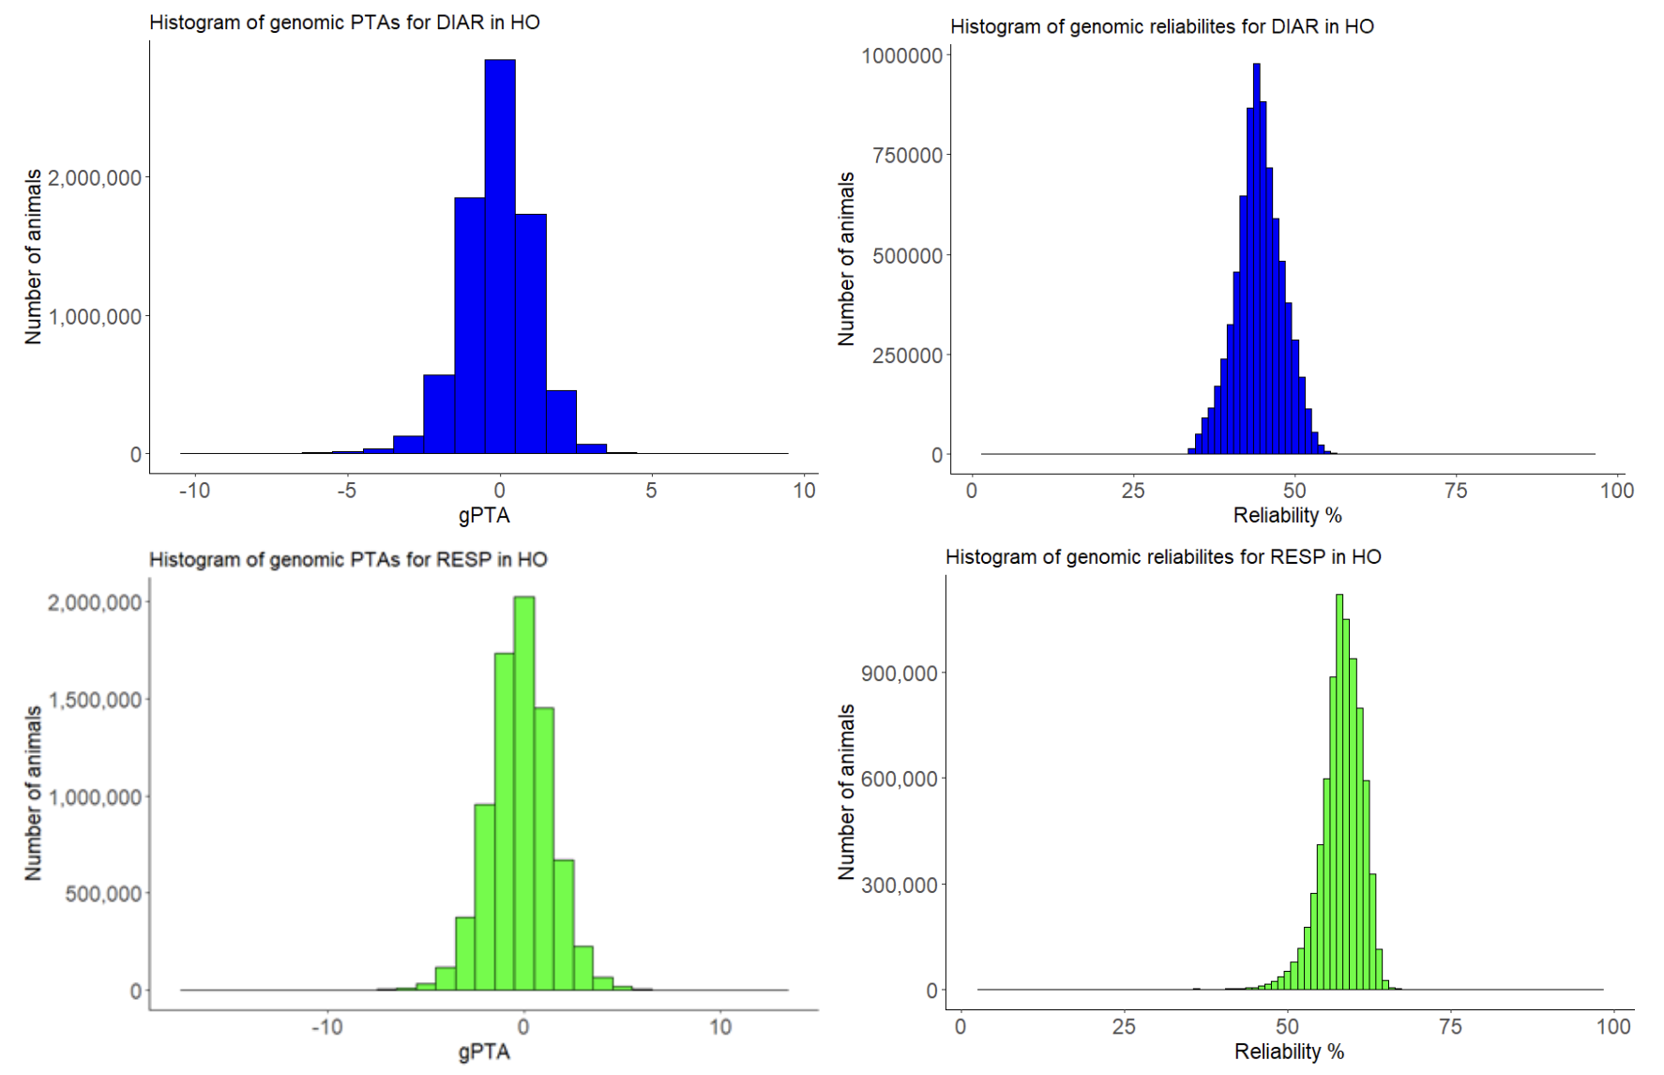
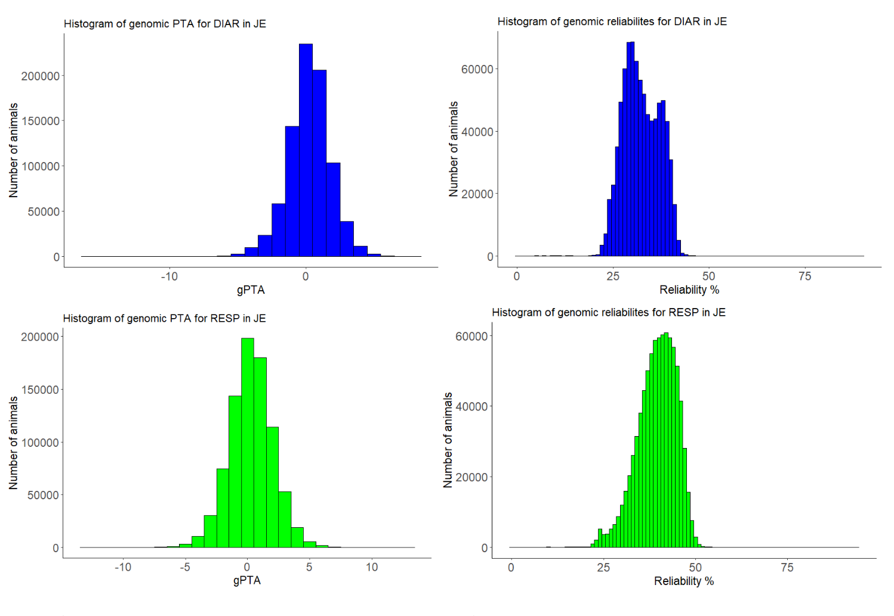
Estimated genomic PTAs and reliabilities
DIAR
RESP
HO
HO
JE
JE

Slide 13
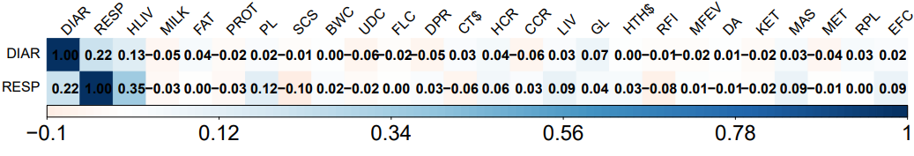
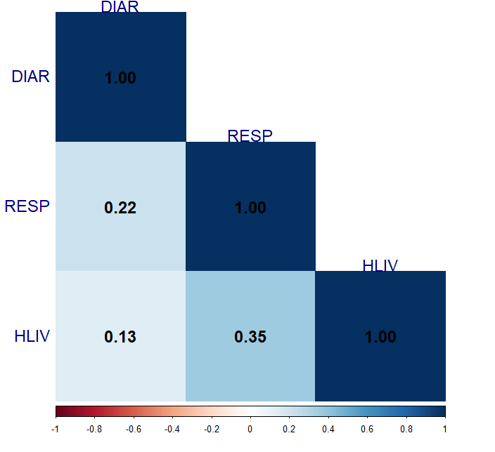
gPTA correlations with net merit traits
Notes:
Genomic predicted transmitting ability correlations between calf health traits, diarrhea (DIAR) and respiratory illnesses (RESP), and 24 Net Merit traits in proven Holstein bulls (reliability >= 85%, n = 4,292)
Correlation between DIAR and RESP was 0.22, while correlations of heifer livability with DIAR and RESP were 0.13 and 0.35, respectively.
Respiratory illnesses and diarrhea, being major causes of pre- and post-weaning deaths in dairy calves, are expected to correlate with heifer livability, which considers heifer deaths from >2 d to 18 mo
Correlations of these two health traits with other traits were low.

Slide 14
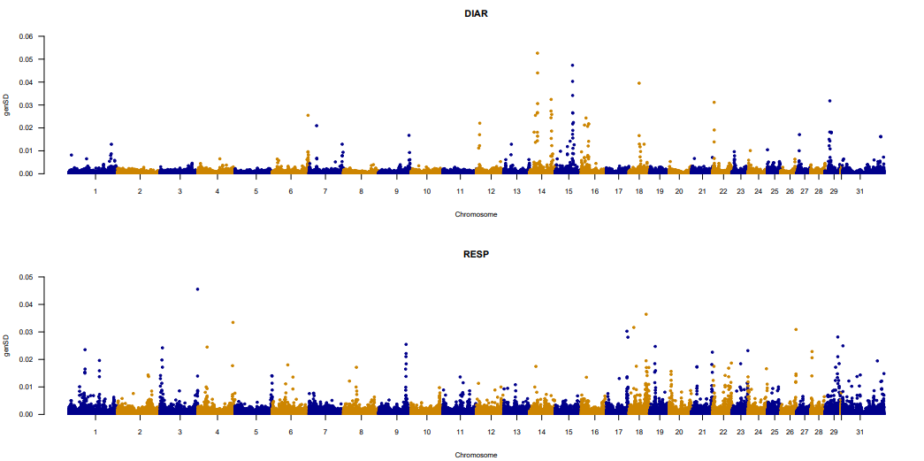
Additive marker effects (HO): within genes
ACER3
CAPN5
CDH11
SH3TC1
CHD7
MYO7A
RBMS3
CA8
FARP2
DNAH11
SULT2B1
TPST2
ITFG1
SEC14L3
AKAP12
MYO1D
PLAAT5
MGMT
Notes:
- SNPs/markers within genes
- Many immune related genes
Two significant additive markers on chromosome 18 associated with DIAR in HO were within the cadherin 11 (CDH11) gene, known to have role in immunity, cell adhesion, and gut epithelium integrity. CDH11 expression is upregulated in the intestines of patient with inflammatory bowel disease
Two significant markers on chromosome 4 associated with RESP in HO fall within the dynein axonemal heavy chain 11 (DNAH11) gene. DNAH11 is essential for motile cilia function in the respiratory tract, where mutations to this gene lead to chronic respiratory infections in humans

Slide 15
Future work
Genome wide association study and pathway analysis with different models for calf health traits (calf livability, diarrhea, and respiratory illnesses)
Collection and continuous data flow
Accurate recordings of phenotypes and improved models

Slide 16
Conclusions
National genetic evaluation system will provide dairy farmers with powerful tools to enhance calf health through selective breeding
More precise and detailed recordings on calf health data will result in increased reliabilities
Continuous flow of data is necessary
Selection of healthy calf will result in profitability and sustainability of herds

Slide 17
Acknowledgments & disclaimers
USDA-ARS project 8042-31000-113-00-D, “Improving Dairy Animals by Increasing Accuracy of Genomic Prediction, Evaluating New Traits, and Redefining Selection Goals”
CDCB and its suppliers of data
Mention of trade names or commercial products in this presentation is solely for the purpose of providing specific information and does not imply recommendation or endorsement by USDA

