Slide 1
How genomics transformed intensive dairy genetic improvement
Dr. John B. Cole
ICAR Annual Conference | April 1, 2025

Slide 2
Topics for discussion
Adoption of genomics in intensive dairying systems
Why genomic selection works so well in dairy cattle
Influence of genomics on farm management
Concluding thoughts

Slide 3
Adoption of genomics in intensive dairying systems

Slide 4
What is the value of genetic selection?
Since 1957, management (dark blue) was 28% of gains, and genetics (light blue) was 71% of gains

Slide 5
Farmers drive genetic improvement
New York
360,783
Minnesota
204,077
Wisconsin
687,737
Pennsylvania
283,390
California
866,259
Texas
262,205
States with >200,000 DHI cows (01/2025)

Slide 6
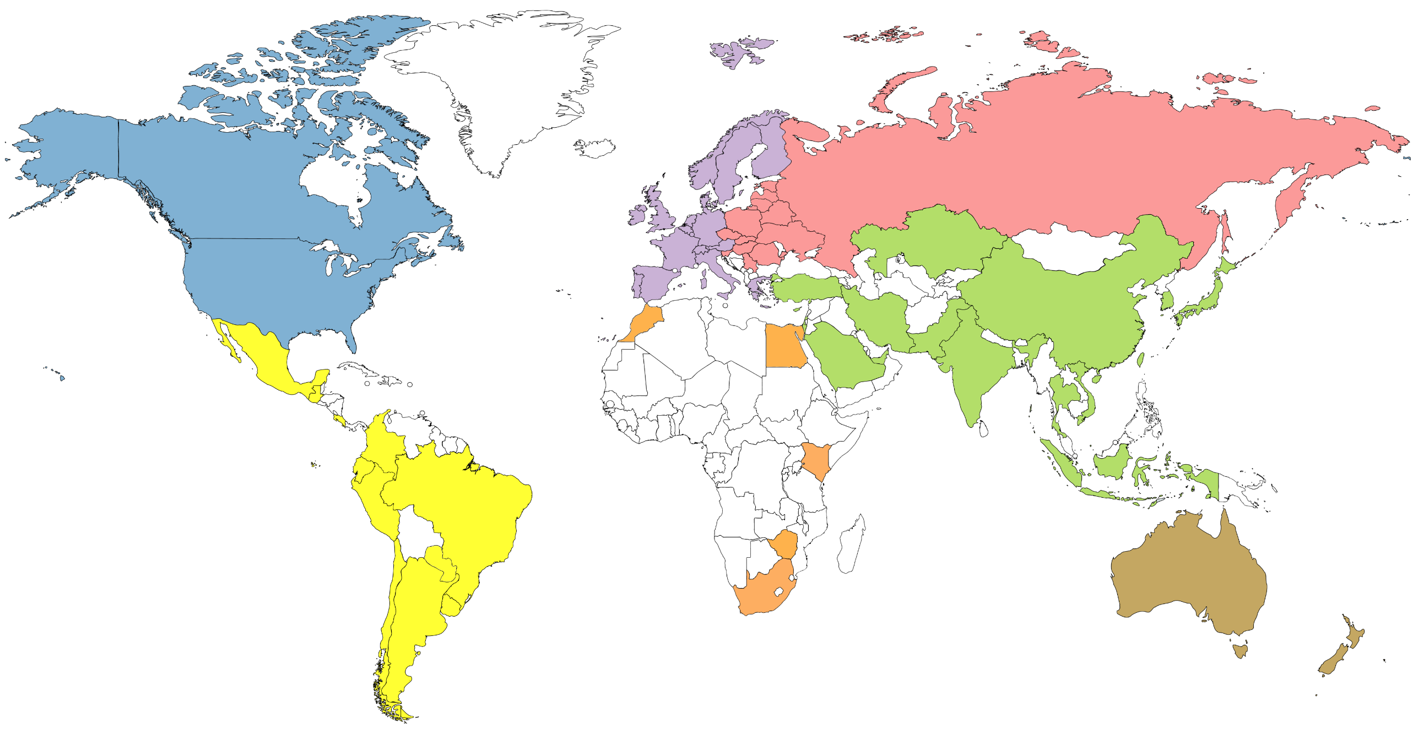
Genotype counts by region (June 2022)
4,974,462
68,684
447,423
420,230
159,563
20,660
67,465

Slide 7
Why genomic selection works so well in dairy cattle

Slide 8
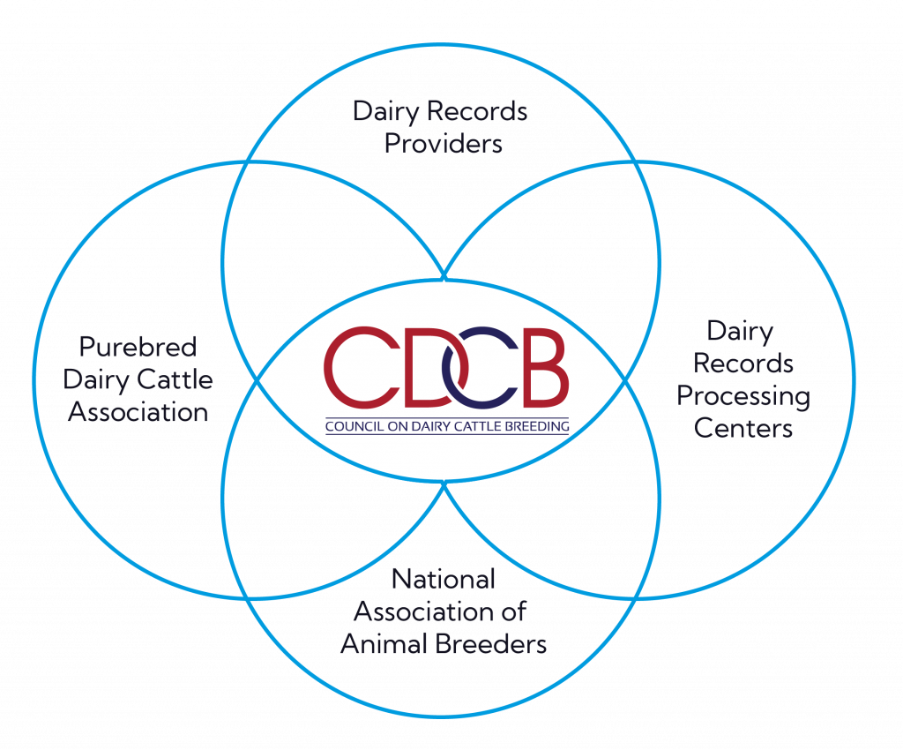
CDCB facilitates genetic improvement
Producer Advisory Committee
Dairy Evaluation Review Team
Genetic Evaluation Methods Group
Evaluation Frequency Task Force
Milking Speed Evaluation Task Force

Slide 9
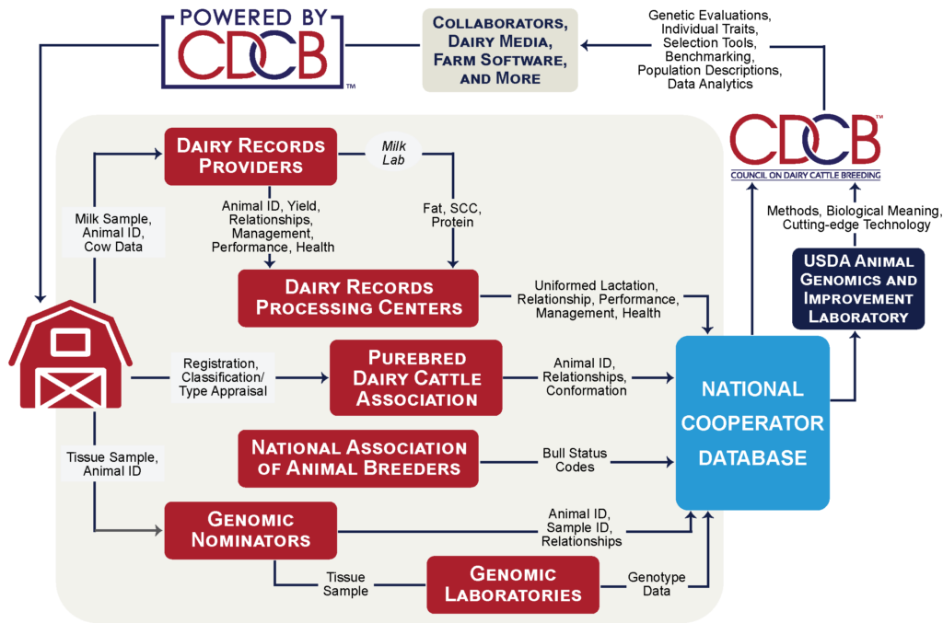
Where do data come from?

Slide 10
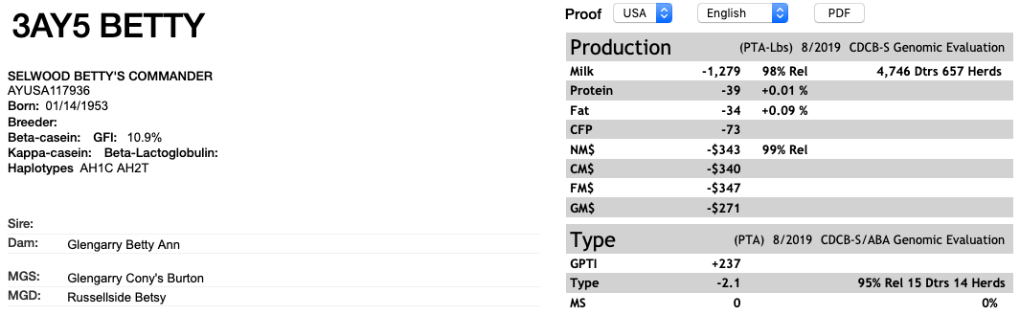
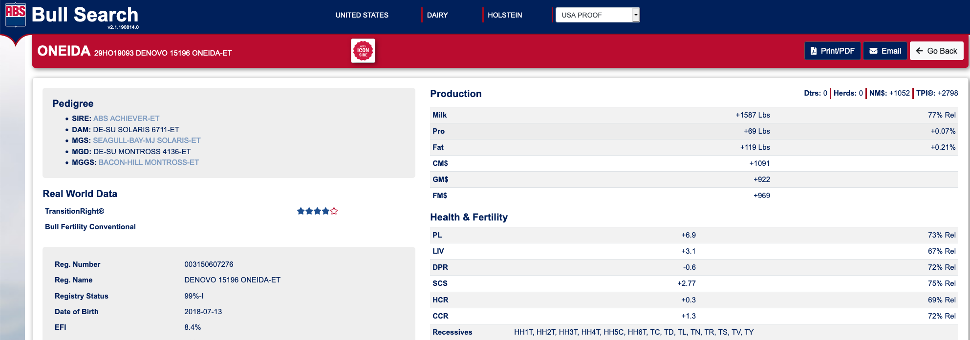
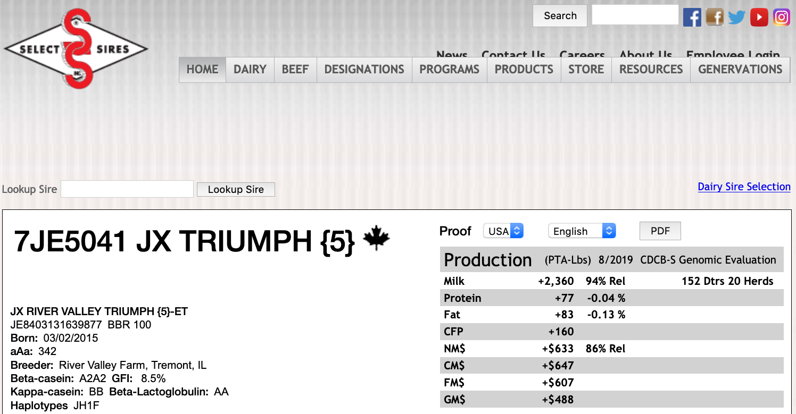
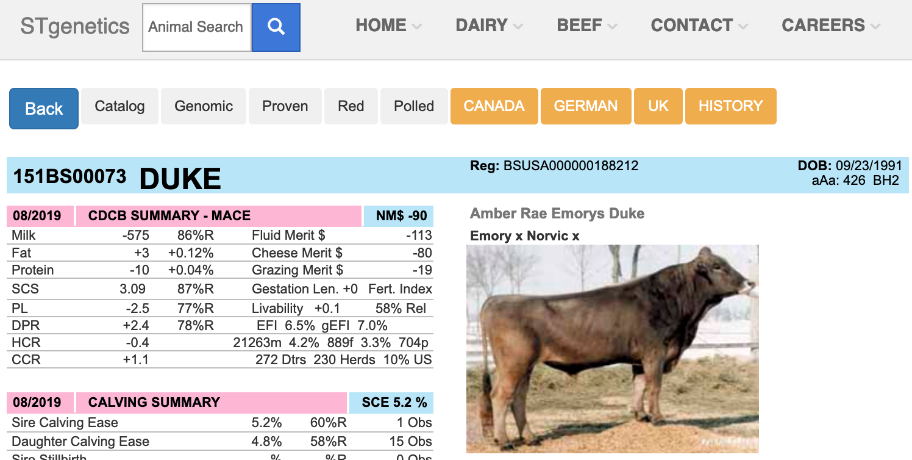
AI companies sell desirable genetics

Slide 11
Influence of genomics on farm management

Slide 12
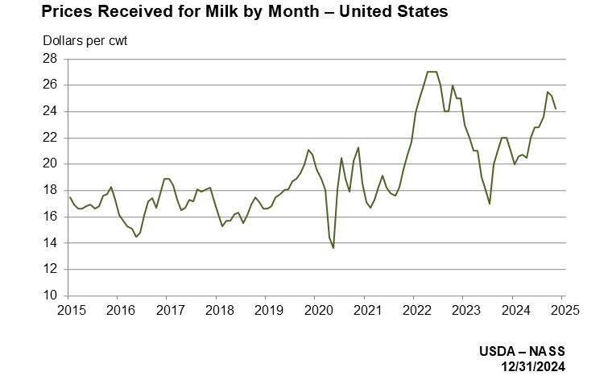
Milk prices are extremely volatile

Slide 13
Better genetics lowers production costs
PTA (predicted transmitting ability) represents ½ of the cow’s genetic merit.
A difference between herds of $439 in PTA NM$ means the cows in the better herd will produce $878 more net profit over their lifetime.
USDA’s calculations have the average 305-ME at 27,000 lbs. and cows milking for 3 lactations.
If the average cost of production per cwt is $18.00…
  A herd with an $878 advantage in the average genetic merit of their cows can produce milk at $16.92 per cwt.
  (Slide courtesy of Dr. Tom Lawlor, Holstein Association USA.)

Slide 14
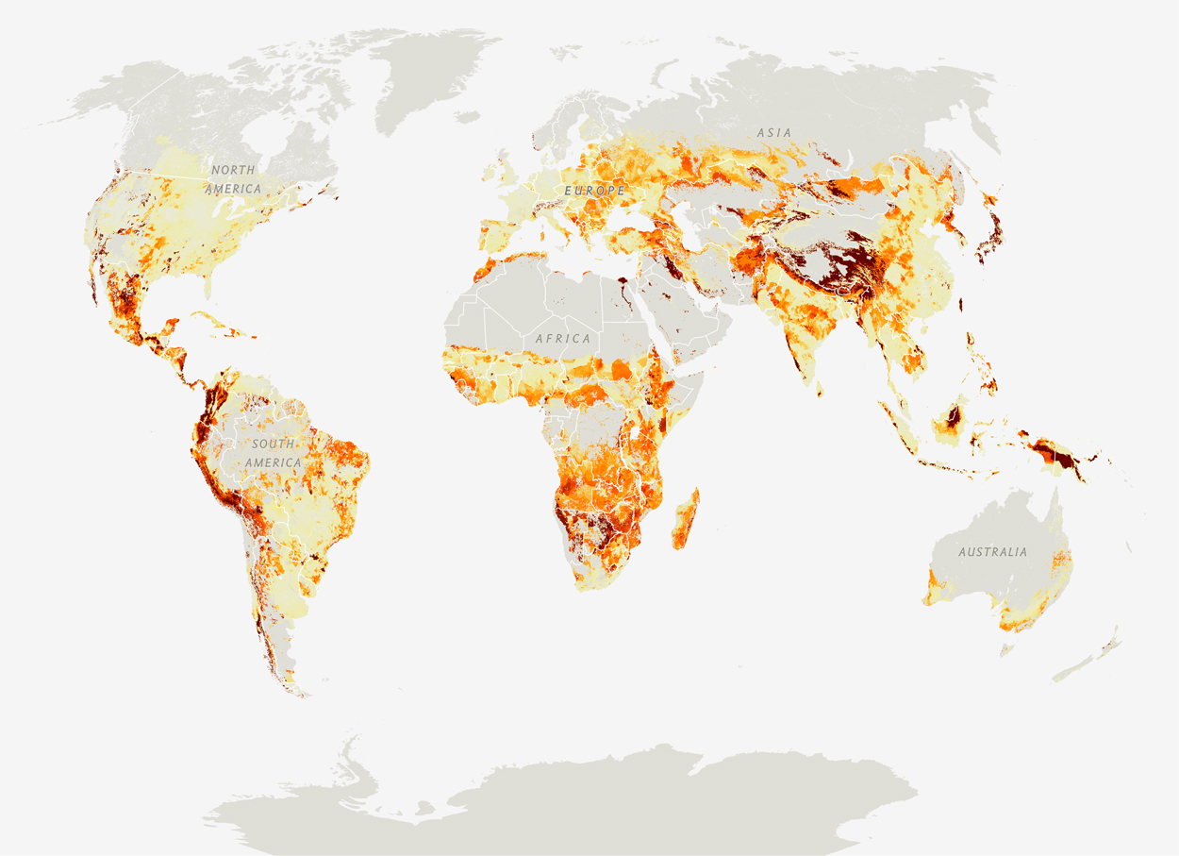
Production must increase as demand for food rises
Genetic gains are cumulative
Healthy farm economies support
healthy national economies
Increased efficiency reduces
environmental footprint
Source: National Geographic (https://www.nationalgeographic.com/foodfeatures/feeding-9-billion/)

Slide 15
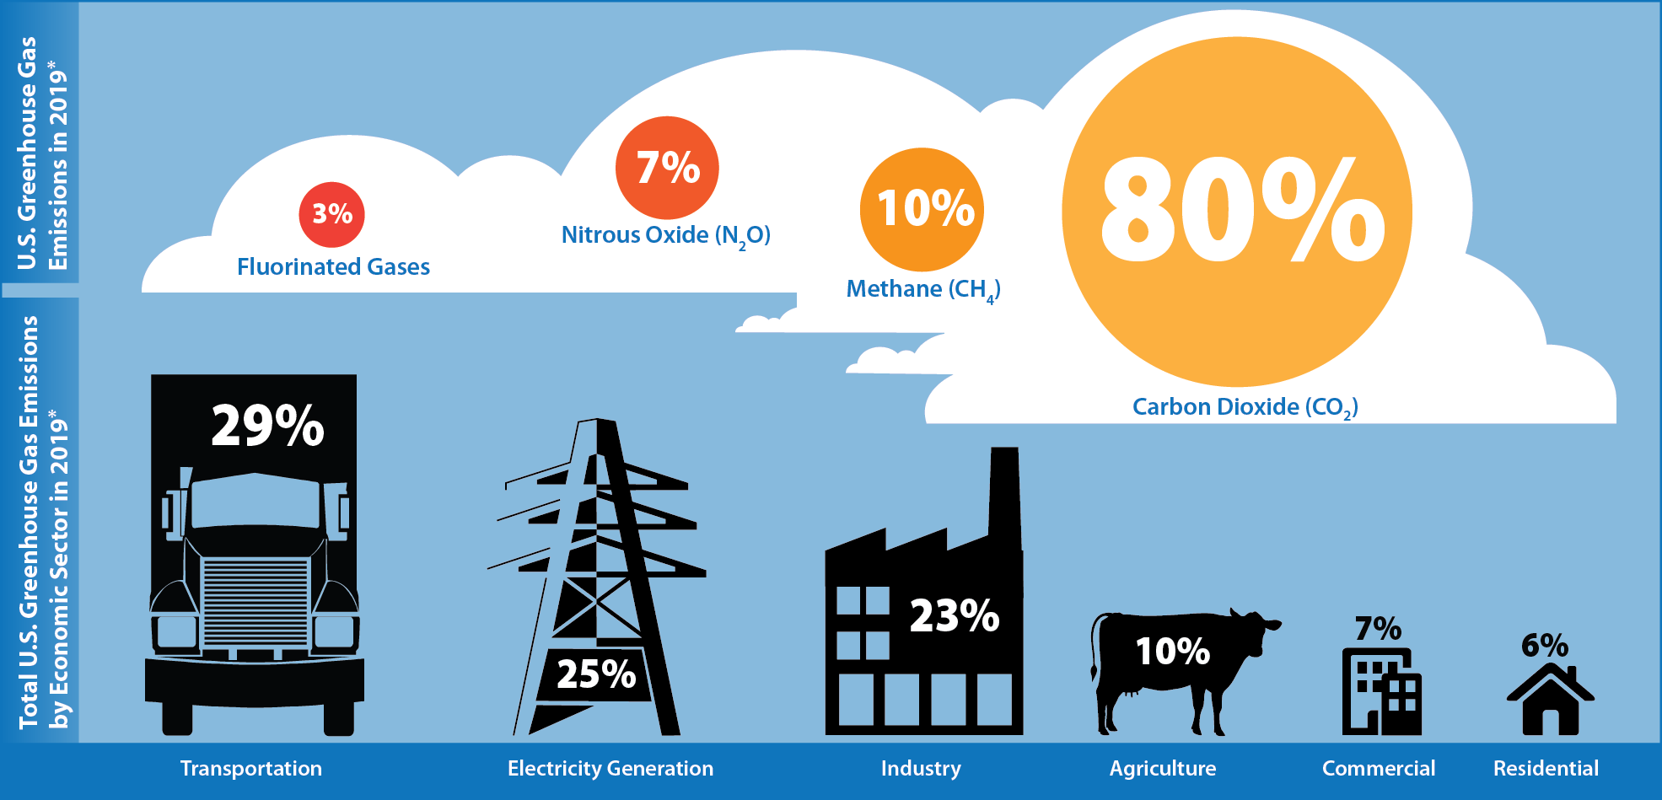
Environmental stewardship matters
Source: U.S. EPA (2021; https://cfpub.epa.gov/ghgdata/inventoryexplorer/).

Slide 16
Concluding thoughts

Slide 17
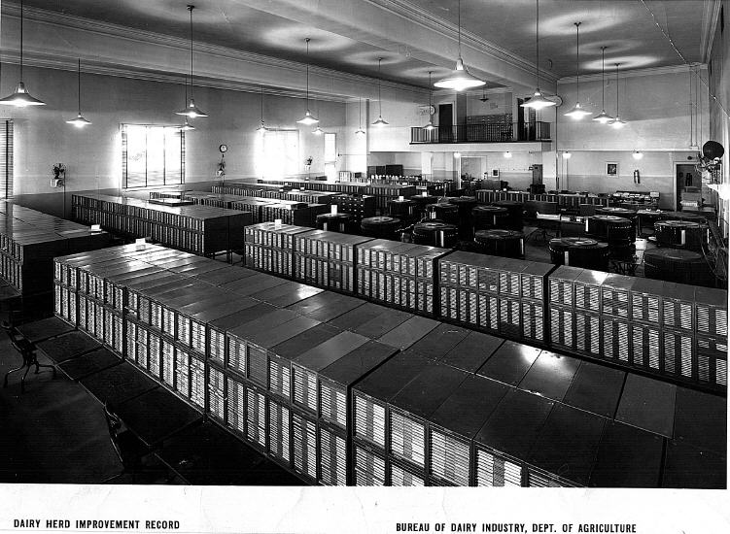
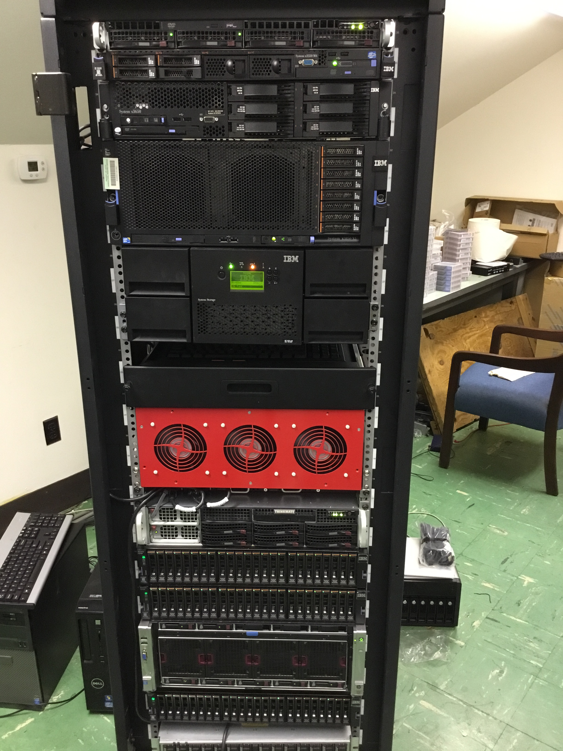
National Cooperators Database
1935
2015

Slide 18
How much data do we have?
Type of information | Number of records
Pedigrees | 75 million
Animal genotypes | 9.5 million
Lactation records | 105 million
Fertility records | 96 million
Health event records | 11 million
Calving difficulty scores | 39 million
Feed intake records | 10,000
Animals receiving evaluations | 80.5 million

Slide 19
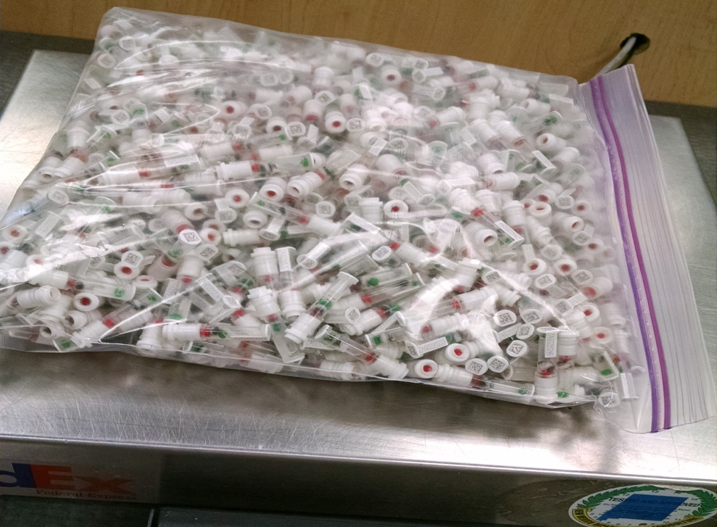
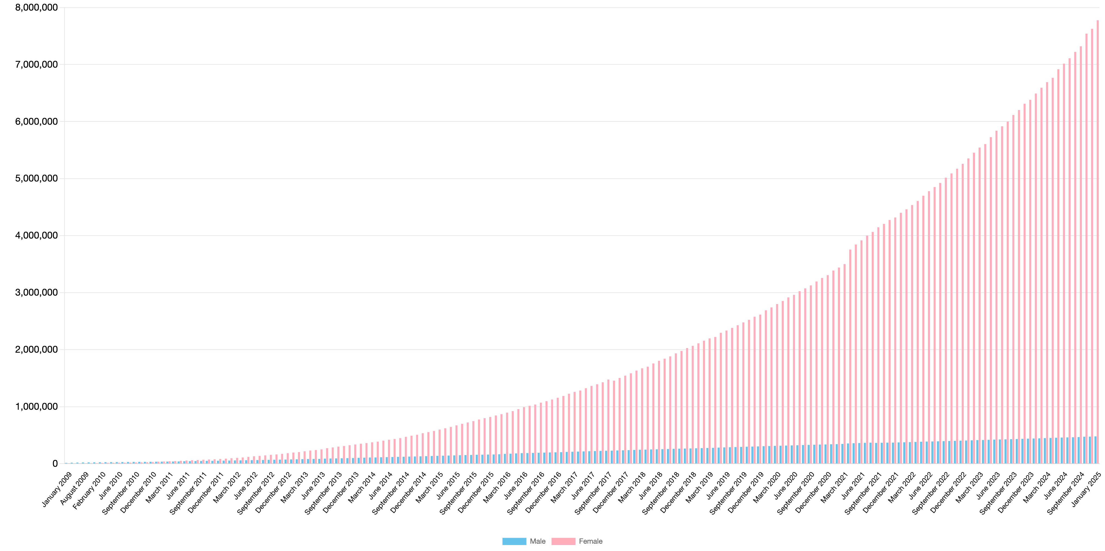
Genotypes are plentiful
Photo: Zoetis

Slide 20

Largest genomic databases
 | Ancestry.com | 23andMe | CDCB/USDA
Genotypes | >25 million | >12 million | >10 million
Species | Human | Human | Cattle
Countries | 88 | >55 | 57
Genotyping cost | $99 | $99 | ~$40+
Delivery (weeks) | 6–8 | “a few” | 1–2
DNA generations | Few | Few | >10
EBV reliability | None | Low | High
Source: https://www.23andme.com/; https://www.ancestry.com/corporate/about-ancestry/company-facts; https://queries.uscdcb.com/Genotype/counts.html.

Slide 21
Traits routinely evaluated in the US
Year | Trait | Year | Trait
1926 | Milk & fat yields | 2006 | Bull conception rate²
1978 | Conformation (type) | 2009 | Cow & heifer conception rates
1978 | Protein yield | 2016 | Cow livability
1994 | Productive life | 2017 | Gestation length
1994 | SCS (udder health) | 2017 | Residual feed intake
2000 | Calving ease (dystocia)¹ | 2018 | Cow health
2003 | Daughter pregnancy rate | 2019 | Early first pregnancy
2006 | Stillbirth rate
¹Sire calving ease evaluated by Iowa State University (1978–99)
²Estimated relative conception rate evaluated by DRMS in Raleigh, NC (1986–2005)

Slide 22
Genomics increased rates of gain

Slide 23
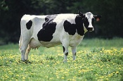
What do SNP genotypes do?
Pedigree information is equivalent to data on ~7 daus.
For protein yield (h² = 0.30), a genotype provides information equivalent to an additional 34 daughters
Notes:
23

Slide 24
Why genomics works for dairy cattle
Extensive historical data available
Well-developed genetic evaluation program
Widespread use of artificial insemination
Progeny-test programs
High-value animals worth the cost of genotyping
Long generation interval that can be reduced substantially by genomics

Slide 25
What’s the best animal we can make?
PTA(NM$) = $3,652 = €3,295
The top bull is OCD THORSON RIPCORD-ET at $1,484
The top cow is GENOSOURCE 84298 KINKY P-ET at $1,548

Slide 26
Inbreeding in US Holsteins (P bulls)
Source: CDCB (2024)

Slide 27
Should we worry about inbreeding?
Change in phenotypic performance per 1% (0.25%) increase in inbreeding
Milk | Fat | Protein | PL | SCS | DPR | HCR | CCR | LIV
-72.4 | -2.66 | -2.08 | -0.28 | 0.01 | -0.20 | -0.21 | -0.29 | -0.10
-18.1 | -0.67 | -0.52 | -0.07 | 0.025 | -0.05 | -0.05 | -0.07 | -0.025
Source: CDCB (https://queries.uscdcb.com/eval/summary/Bmean_bases_het.cfm).
Change in genetic potential per year when selecting on NM$
Milk | Fat | Protein | PL | SCS | DPR | HCR | CCR | LIV
+126.9 | +7.7 | +4.4 | +0.49 | -0.02 | +0.03 | +0.15 | +0.15 | +0.25
Source: AGIL, ARS, USDA (https://www.ars.usda.gov/ARSUserFiles/80420530/Publications/ARR/nmcalc-2021_ARR-NM8.pdf).

Slide 28
Known genetic defects in US Holsteins
Haplo- Type | Functional/Gene name | BTA chromosome | Location (Mbp) | Haplotype frequency (%) | Timing¹
HCD | Cholesterol deficiency/APOB | 11 | 78.0 | 0.34 | W
HH0 | Brachyspina/FANCI | 21 | 21.2 | 0.28 | E,B
HH1 | APAF1 | 5 | 63.2 | 0.40 | E
HH2 | IFT80 | 1 | 107.1 | 0.68 | E
HH3 | SMC2 | 8 | 95.4 | 0.65 | E
HH4 | GART | 1 | 1.3 | 0.09 | E
HH5 | TFB1M | 9` | 91.28– 91.9 | 2.50 | E
HH6 | SDE2 | 16 | 29.0 | 1.14 | W
HHB | BLAD/ITGB2 | 1 | 145.1 | 0.03 | W
HHC | CVM/SLC35A3 | 3 | 43.4 | 0.25 | E,B
HHD | DUMPS/UMPS | 1 | 69.8 | 0.00 | E
HHM | Mule foot/LRP4 | 15 | 77.7 | 0.00 | B
HMW | Muscle weakness/CACNA1S | 16 | 79.6 | 2.04 | B
¹Timing of embryonic loss/calf death for homozygous animals: B = calf death at/shortly after birth,
E = embryonic loss/abortion, W = calf death weeks/months after birth (Cole et al., 2018).

Slide 29
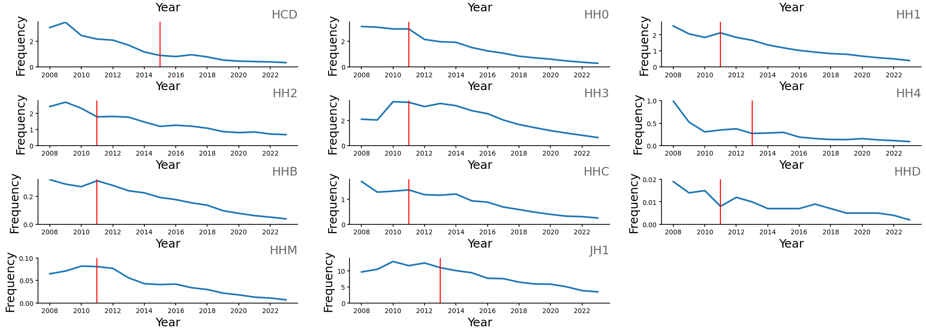
Changes in haplotype frequency
Cole et al. (2025, in press)

Slide 30
Is the number of defects increasing?
Cole et al. (2025, in press)

Slide 31
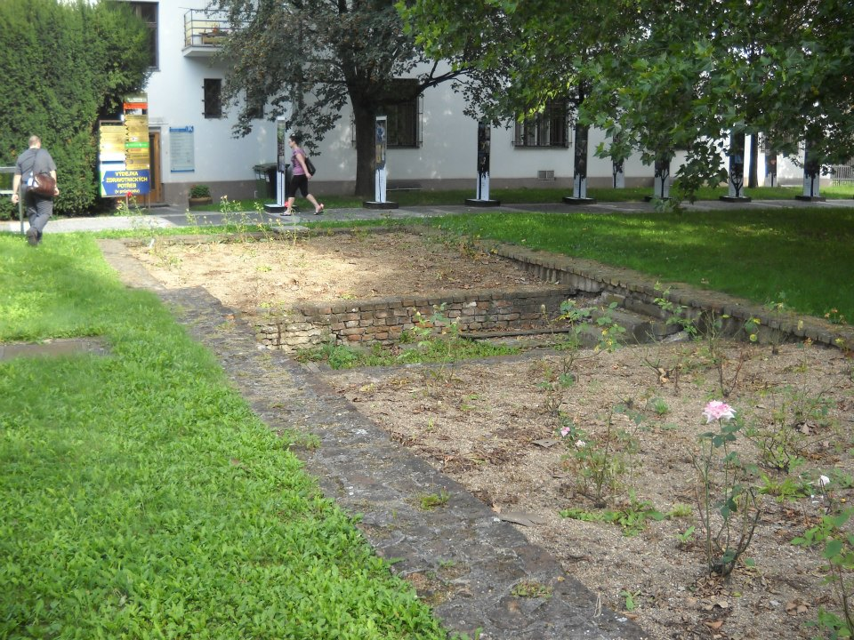
Questions?
Foundation of Gregor Mendel’s greenhouse, Brno, Czech Republic.

